Slide 1

AUTOMATION OF HOSPITAL MANAGEMENT SYSTEM
This Photo by Unknown Author is licensed under CC BY-SA
Our project aims at automating different wards of Hospitals( especially which are rural based and lacks adequate facilities) so as to reduce the risk of contamination which has become the need of the hour during this Covid-19 pandemic.

Slide 2
PROBLEM STATEMENT AND OUR BUSINESS IDEA
MAJOR OBSTACLES IN RURAL HEALTHCARE INDUSTRY
The 5 A’s:
2. The stakeholder ecosystem is
complex and lacks effective strategy:
OUR BUSINESS IDEA
IMPACT
Our mission is to form a co-operative society (SWASTHYA) by bringing together small scale Hospitals and few private Hospitals/healthcare organizations which work on scalable model.
To target on mega industries which focus on volume and scalable model (e.g. Tata Memorial) to partner with us which would strengthen people’s belief in our partner small scale hospitals.
Prime focus is to expand the market by above mentioned methods by maintaining a proper balance in stakeholder ecosystem.
The technological approach to deal with contamination and avoid overcrowding in hospital premise will attract people who earlier doubt medical facilities of small scale rural based hospitals.
Provide partner hospitals certification upon duly installing and testing of our product. This would give them an identity of ‘SAFE HEALTH CARE SERVICES’ and would act as a magnet for other hospitals to join our society.
As a whole, this society will boost the service sector rural healthcare services.
It will help to win over the fear of people who doubt medical facilities of small scale hospitals, taking advantage of which large hospitals inflate medical treatment costs.
The healthcare services gap will reduce and thus a robust system will be build which also insures more job opportunities in rural areas.
This will also insure to overcome the 5 A’s and as healthcare sector will boost it will also add to the nation’s economy which is also the need of the hour.
Lack of awareness
Lack of availability
Lack of accountability
Lack of affordability
Lack of access
Hospital/ Physician
Patients
Pharmaceutical Companies
Insurance Companies

Slide 3
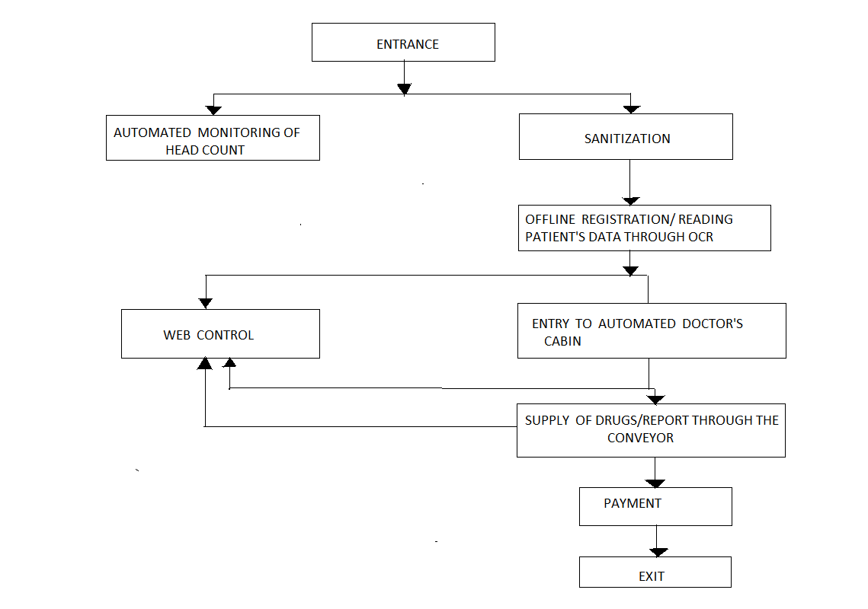
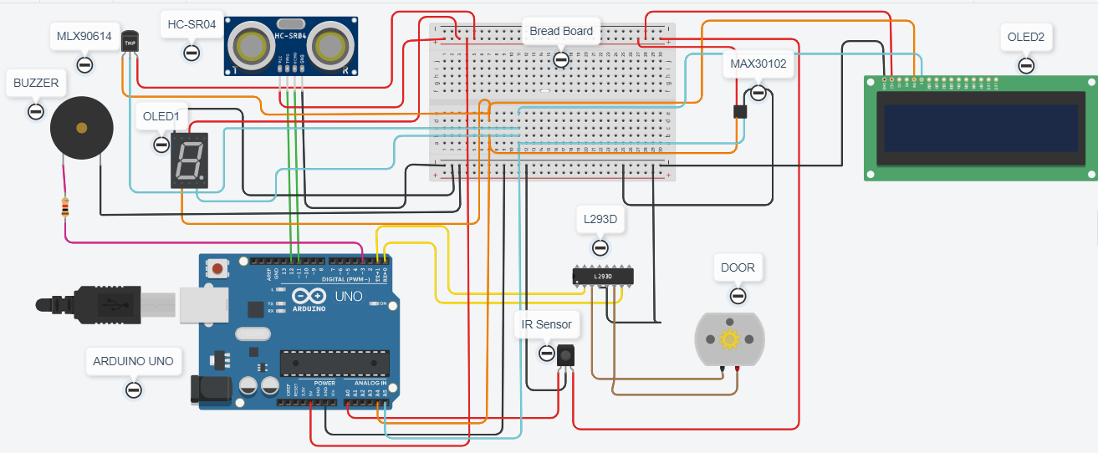
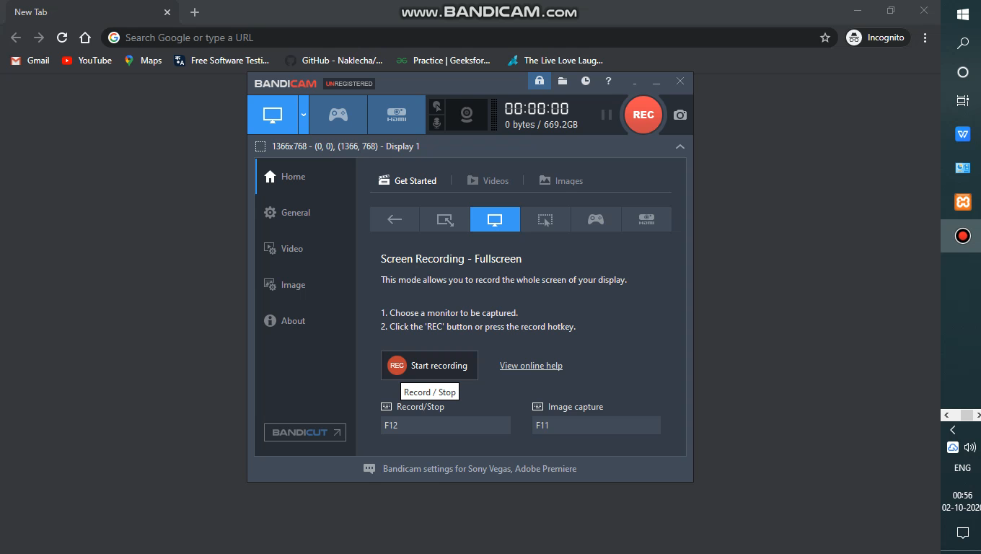
WORKFLOW OF OUR AUTOMATED HOSPITAL
1.Circuit Diagram of Automated Cabin
NOTE: The attached file 1 and 2 are just the part of our project. Actual project includes technological functioning of every subpart as mentioned in above flowchart.
2. Working of our Website (video file)

Slide 4
Contact
Team Member Details:
GROUP MENTOR- Mr. DEEPAK SINGH singh.deepak@siemens.com 9029140688
NAME | E-mail address | Contact Number
DEEKSHA MAURYA | deeksha.mnnit18@gmail.com | 8887873434
IMPANA H.C | impanahcgowda17@gmail.com | 7483915336
LEYA SUSSAN | leyasussan09@gmail.com | 7025162024
MANISHA SAH | manisha2000sah@gmail.com | 8910856656
PRIYANKA SONI | priyankasoni01999@gmail.com | 7320972030
SNEHA G. R | snehagr69@gmail.com | 9483146051
VISHAL SINHA ( Team Leader) | vishalsinha291@gmail.com | 6205065207

